Slide 1



Slide 2

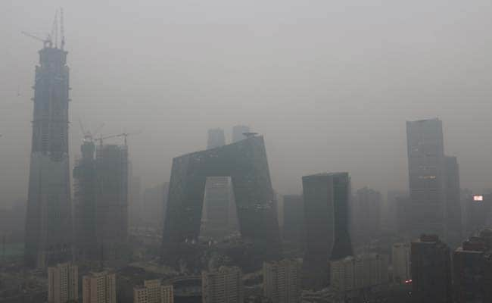


THE REAL PROBLEM

Slide 3
GLOBAL TENDENCY

Slide 4
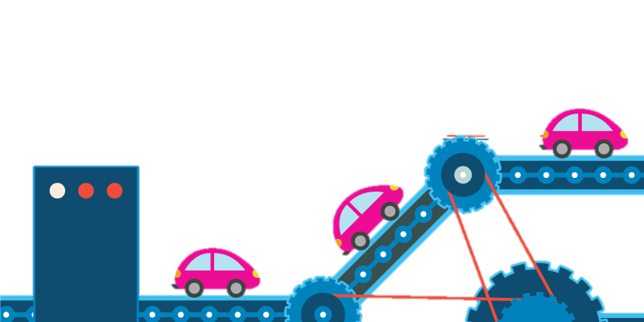


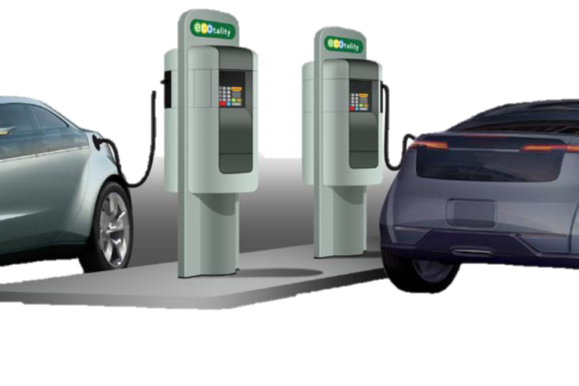
ECOSYSTEM
CAR
Manufacturers
EMSP
BANKS
PEOPLE
Billing
and Settlers
ENERGY
Producer
Charging Network

Slide 5
COMPLEXITY
CAR
Manufacturers
EMSP
BANKS
PEOPLE
NIGHTMARE
Billing
and Settlers
ENERGY
Producer
Charging Network

Slide 6
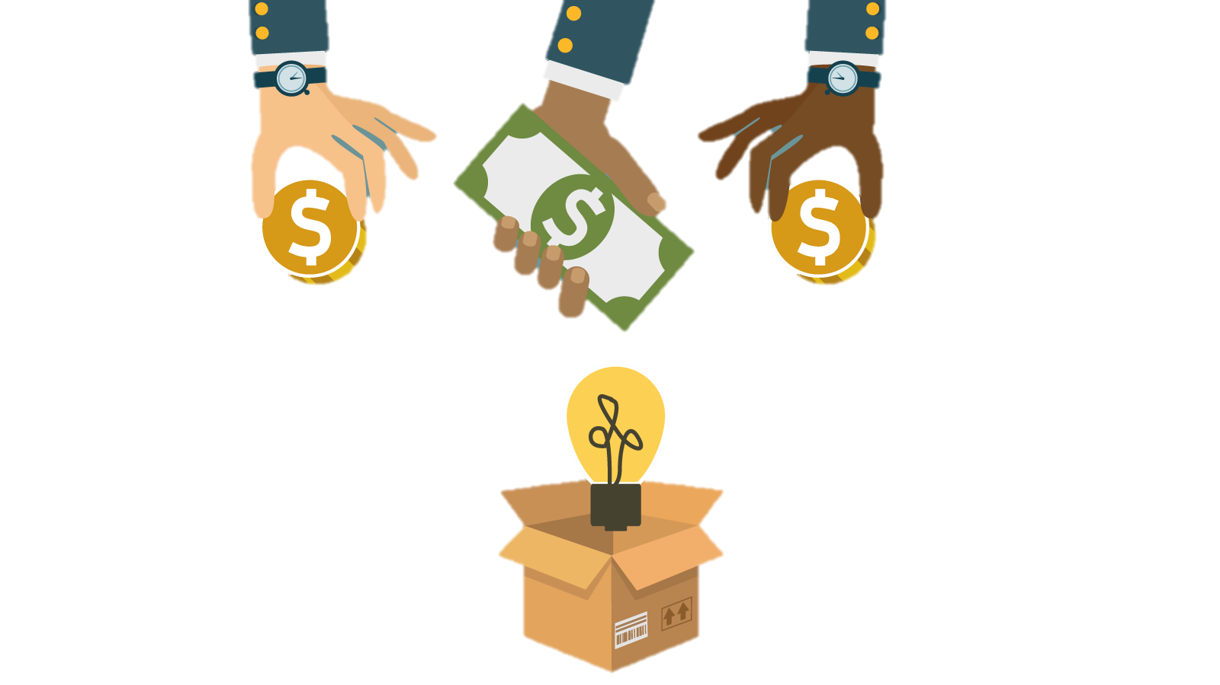


WE present the EMt (electric mobility token)
CAR
Manufacturers
EMSP
BANKS
PEOPLE
ENERGY
Producer
X
Charging Network
Billing and Settlers

Slide 7
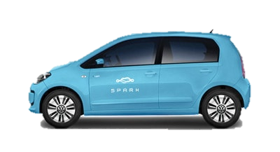
WE present the EMt (electric mobility token)
CAR
Manufacturers
EMSP
BANKS
X
PEOPLE
Billing and Settlers
CHARGING
Charging Network
ENERGY
Producer

Slide 8
WE present the EMt (electric mobility token)
CAR
Manufacturers
EMSP
BANKS
PEOPLE
LEASING
X
Charging Network
ENERGY
Producer
Billing and Settlers

Slide 9
WE present the EMt (electric mobility token)
CAR
Manufacturers
EMSP
BANKS
PEOPLE
Charging Network
SETTLEMENT
X
ENERGY
Producer
Billing and Settlers

Slide 10
START BY VERIFYING
CAR
Manufacturers
EMSP
BANKS
PEOPLE
BLOCKCHAIN VERIFIED
Charging Network
ENERGY
Producer

Slide 11
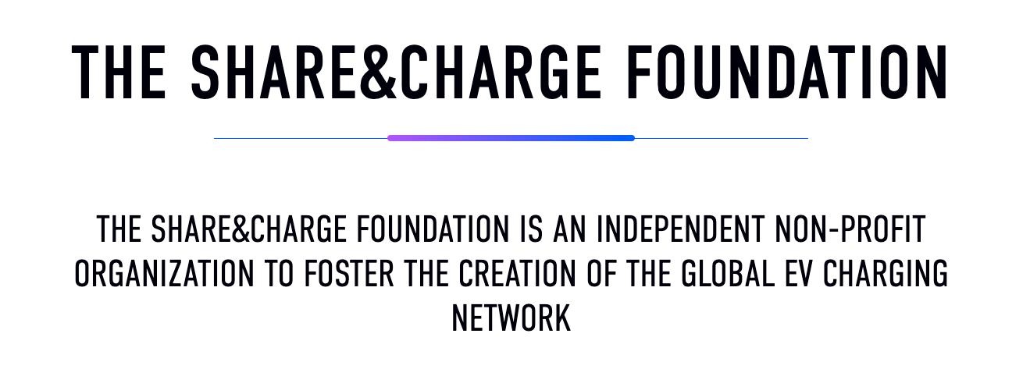
IT IS ALREADY HAPPENING!

Slide 12
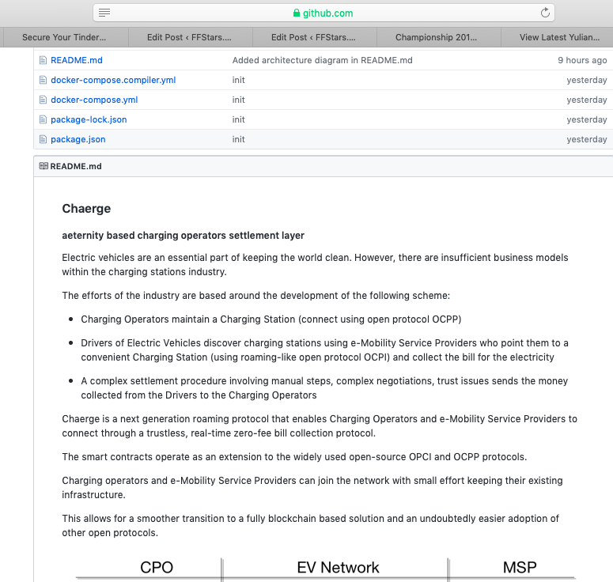
PROJECT REpo
github.com/asotirov/chaerge-aeternity-haeckathon-2019

